Slide 1

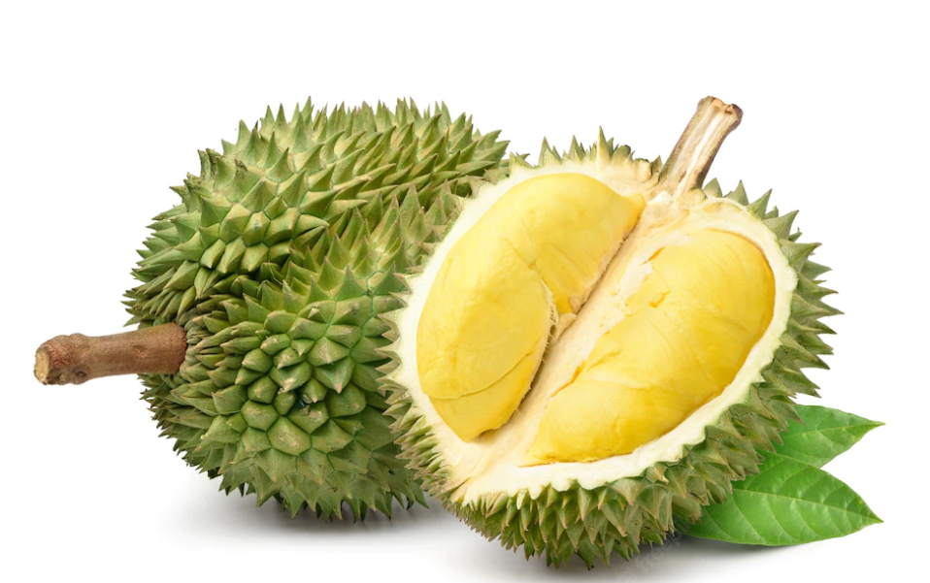
Ge
Genome Analyses Project
The draft genome of tropical fruit durian (Durio zibethinus)
Paper4
Nanxing Liu
MSc Bioinformatics program

Slide 2
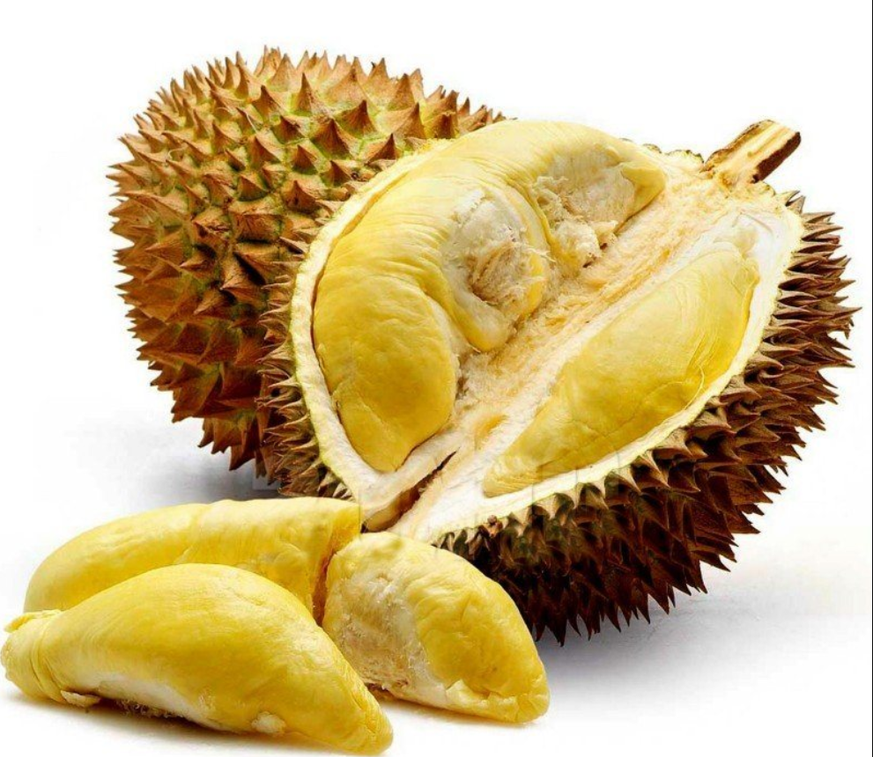
What did the paper do
Draft genome assembly
Musang King fruit stalk
Transcriptomic analysis
between different plant organs (non-fruit and fruit)
between fruit from different cultivars (Musang King , Monthong, Puang Manee )
Notes:
Durian is a Southeast Asian tropical plant.
It’s fruit has hefty, spine covered, and very strong sulfury like odor 欧der .
But it non-fruit part don’t have these.
Cultivars 品种 Musang 木桑 Monthong 吗桑

Slide 3
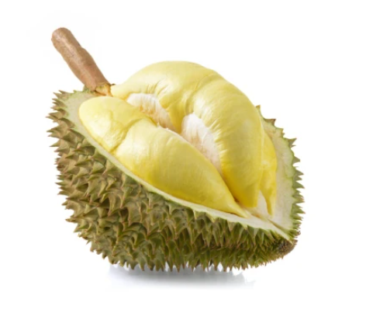
Type of Sample and Data
What did we do
Data:
DNA- Long reads (Pacbio)
- short reads (Illumina)
RNA- 6 paired trimmed short reads
- 3 paired untrimmed short reads
(Illumina)
scaffold 6,10,11 are given.
We Only chose Scaffold_11
Sample:
Genomic analysis:
Musang King fruit stalk
Transcriptomic analysis:
3 Musang King fruit arils MK
3 Monthong fruit arils MT
3 Puang Manee fruit arils (don’t use )
3 Musang King non-fruit parts
(stem, root, and leaf) MK
Notes:
Stalk 大
aril 爱 柔 stem 但

Slide 4
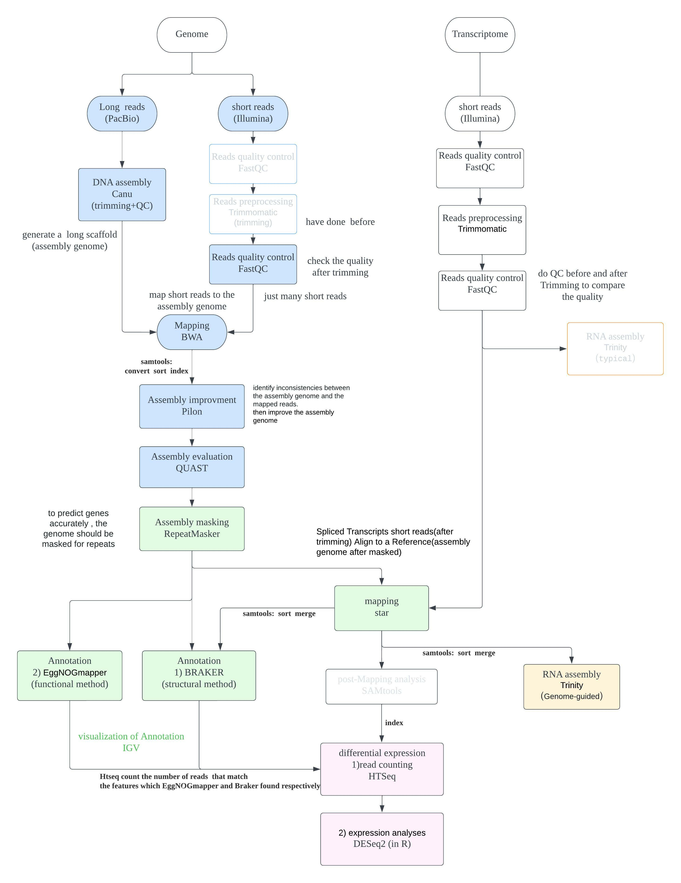
Workflow
De Novo Genome Assembly
Structural and functional annotation
Differential expression analyses
Transcriptome assembly (extra)
Notes:
My work is mainly carried out around these four parts.
In the pipeline, I marked 4 different sections with four different colors.
Then I will explain them in detail, according to this picture

Slide 5
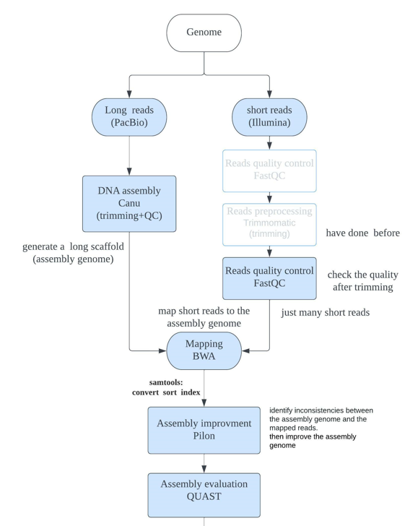
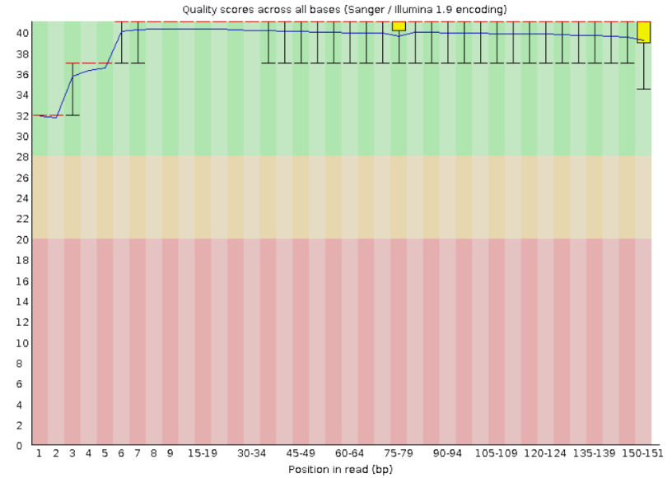
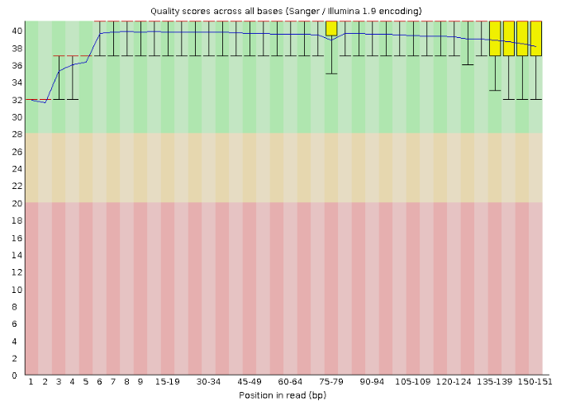
De Novo Genome Assembly
1. Genome Illunima short reads QC (FastQC)
trimmed paired reads (11.1P /11.2P)
The quality look quite nice!
Since already trimmed
Notes:
First, we use FastQC to check the quality of…. They are already trimmed paired reads, so…
Then we can skip the trimming step and use them directly,

Slide 6
De Novo Genome Assembly
2. Genome assembly of PacBio long reads (Canu)
Canu operates in three phases: correction, trimming and assembly
output `DNA_pacbio_assembly_11.contigs.fasta`
3. Correct assembly with short reads (BWA, Pilon)
BWA: map the DNA short reads to the long reads assembly
Pilon: uses short reads alignment(BWA) against long reads assembly to identify inconsistencies to improve assembly. (polishing)
Notes:
Inconsistencies
Pilon can make improvements to (assembly genome of Canu) (solve like Single base differences, indels...).

Slide 7
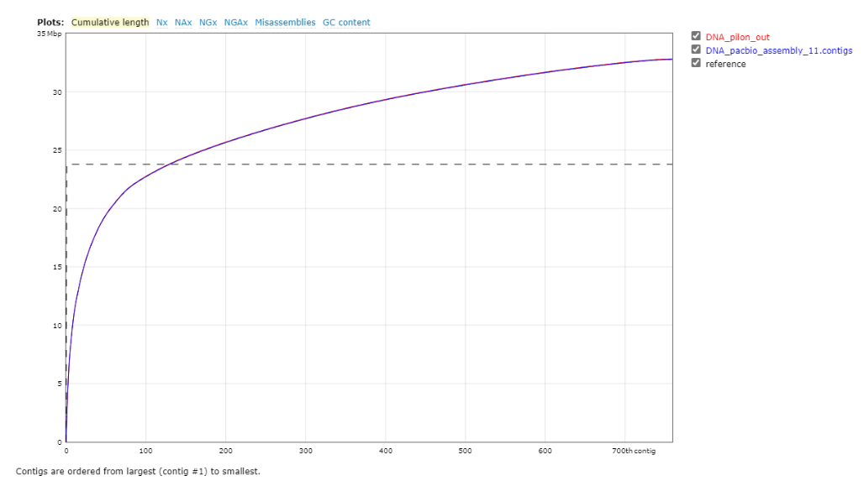
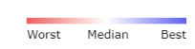
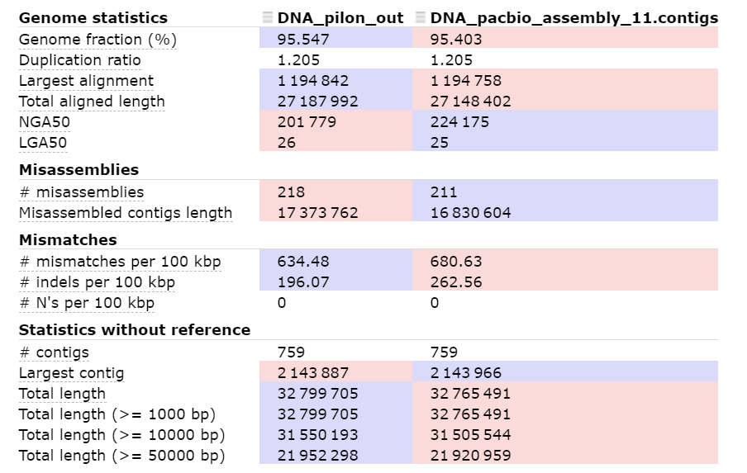
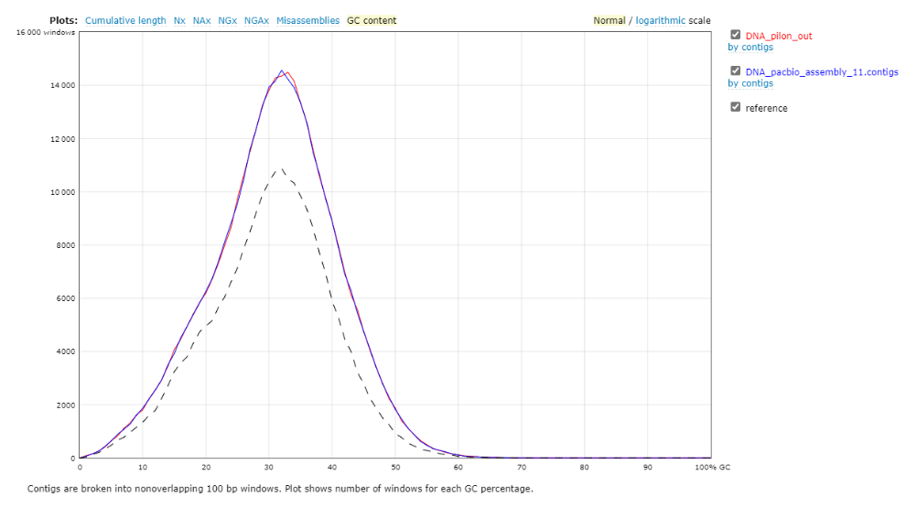
De Novo Genome Assembly
4. Assembly quality (Quast)
Compare: Canu Plion reference genome
Notes:
heatmap:
Pilon_genome's genome fraction percentages on reference genome,NG50, aligned length, contigs total length are a bit better than Canu_genome.
But Pilon_genome's misassemblies is little worse than Canu_genome(but not too much).
Cumulative length plot:
The genome size of Pilon_genome(red line) and Canu_genome(blue line) are almostly identical, but both of them are above on the reference genome (dashed 带 line), which maybe caused by any contaminant in our assembly genomes or much heterozygous genome of durian.
GC content plot:
Both Pilon_genome(red line) and Canu_genome(blue line) are quite simiar and tight, but they are separated from reference genome (dashed line).Means their composition of GC are samilar but different from reference.
In conclusion, the Pilon_genome is a bit better than Canu_genome. Plion improved the draft assembly genome

Slide 8
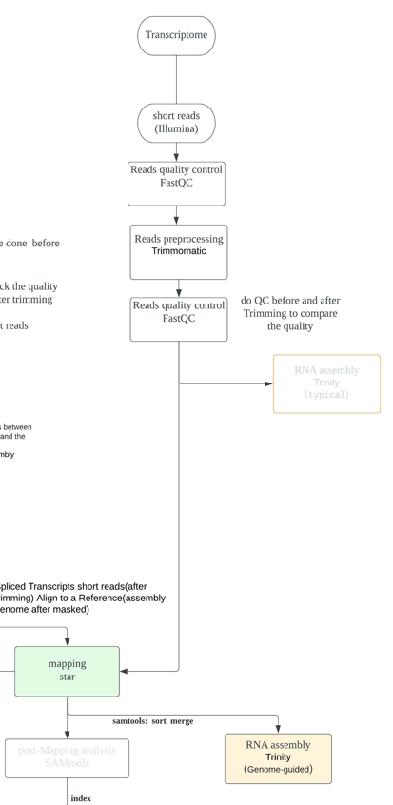
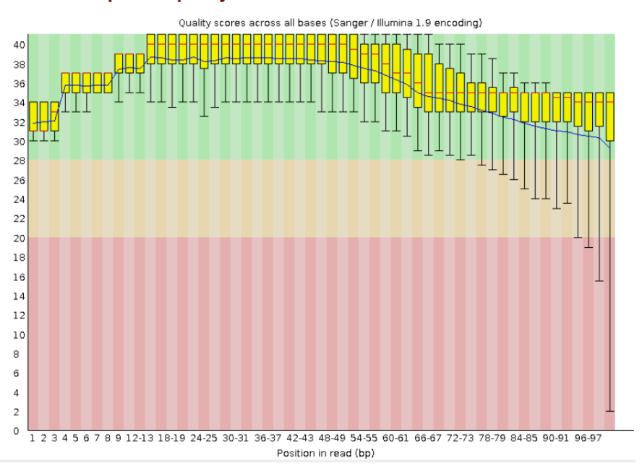
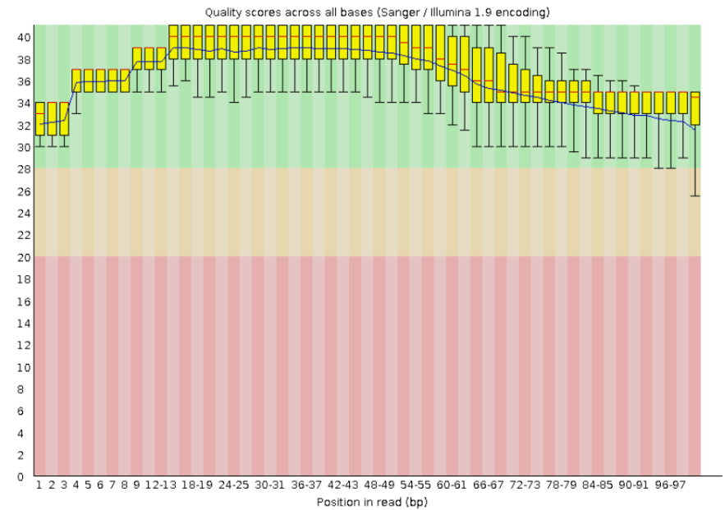
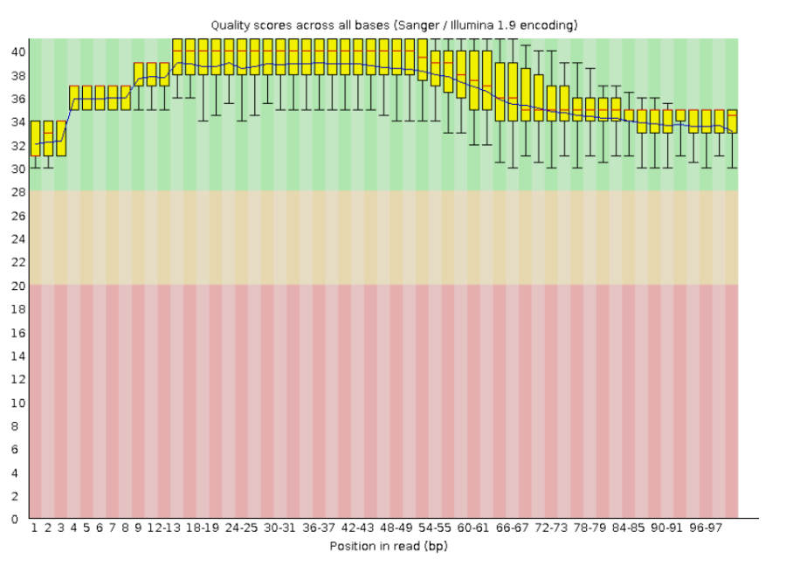
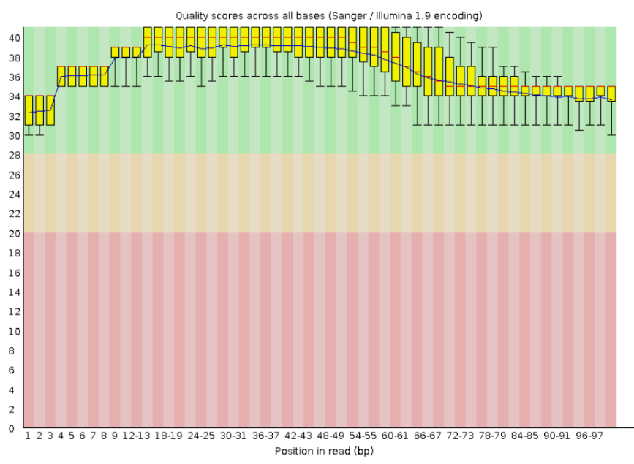
Structural and Functional Annotation
1. RNA short reads preprocessing:
trimming (Trimmomatic) + quality check (FastQC)
Before
1 Paired forward reads 2 Paired reverse reads
After
Notes:
Since some of our RNA short reads are untrimmed, so we trimmed them and check the quality.
Then the quality become better, then we will use all of trimmed RNA reads to do mapping with Star.

Slide 9
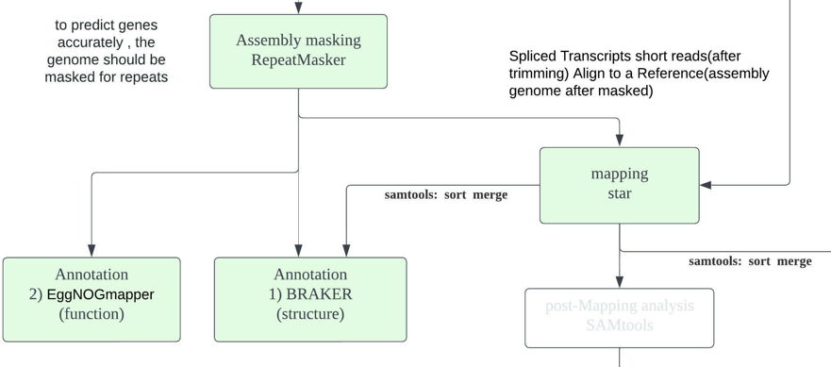
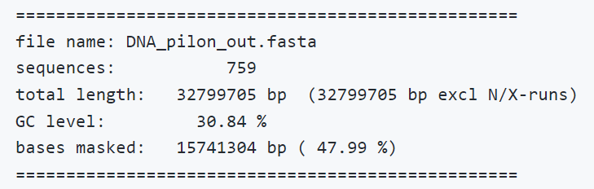
Structural and Functional Annotation
2. Masking assembly genome (RepeatMasker)
In order to predict genes more accurately, the genome should be masked for repeats.
similar result to the paper(54.8%), masked 47.99% repetitive regions.
Note: Higher masking could decrease the difficulty of annotation but also cause loss of potential genes.
Notes:
RepeatMasker can screens DNA sequences and detects repeats and low complexity regions.
Soft masking we use.
approximately 50

Slide 10
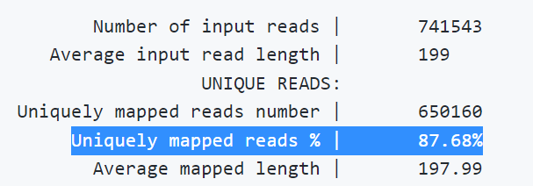
Structural and Functional Annotation
3. RNA mapping (Star)
mapping all paried RNA_reads(after trimmed) to assembly genome (after masked ). Output some bam files.
mapping quality: “Uniquely mapped reads” of each pair RNA is over or around 80%, which is good.
4. Sort and merge (Samtools)
Sort and merge all mapping result (.bam) together to one bam file in order to do the structural annotation(Braker).
Notes:
Uniquely mapped read: a read which mapped only once in a genome. We Hopefully the match would be a unique exact match.
multi-mapped reads are the sequences that map more than one time on the genome,

Slide 11
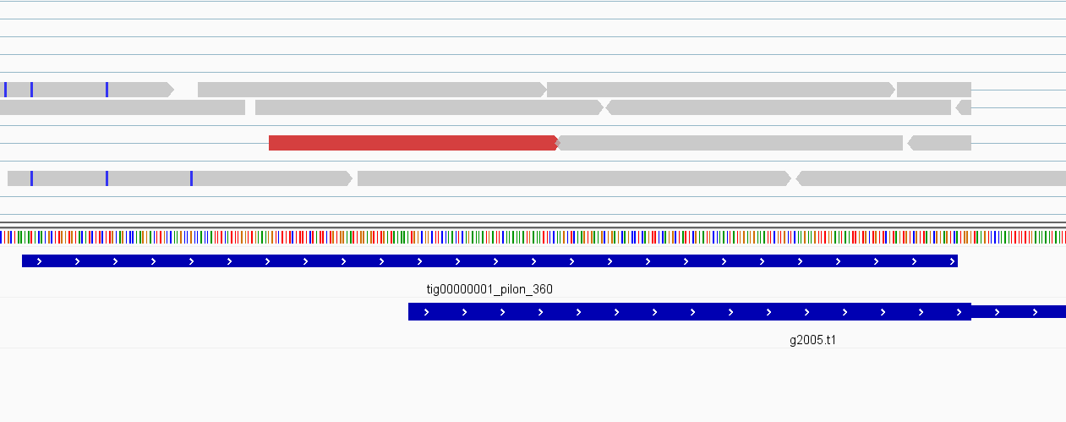
Structural and Functional Annotation
5. Structural annotation (Braker)
6. Functional annotation (EggNOGmapper)
7. IGV
masked assembly genome
Sorted_merged.bam after mapping (with indexed .bai)
eggnogmapper_out.emapper.gff
augustus.hints.gff3 (braker)
Notes:
Upper Braker: uses genomic and RNA-Seq data to generate full gene structure annotations in novel genomes.
Lower eggNOGmapper: uses known information of eggNOG database to transfer functional information from orthologs
These two tools use different methods to predict gene model, so compare them we can see they have different prediction of genes.

Slide 12
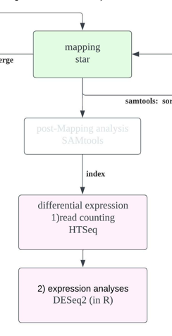
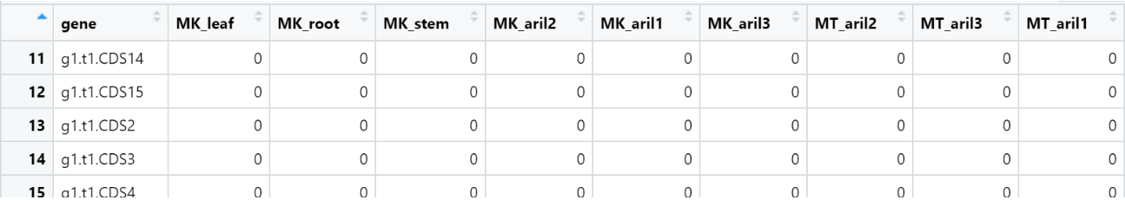
Differential expression analyses
Counting reads (Htseq)
counting reads that map on genomic features (only use Braker found)
SRR6040092_11_Aligned.out.bam_sort.txt Musang King: leaf
SRR6040093_11_Aligned.out.bam_sort.txt Musang King: root
SRR6040094_11_Aligned.out.bam_sort.txt Musang King: aril 2
SRR6040095_11_Aligned.out.bam_sort.txt Musang King: aril 1
SRR6040096_11_Aligned.out.bam_sort.txt Musang King: stem
SRR6040097_11_Aligned.out.bam_sort.txt Musang King: aril 3
SRR6156066_11_Aligned.out.bam_sort.txt Monthong: aril 2
SRR6156067_11_Aligned.out.bam_sort.txt Monthong: aril 3
SRR6156069_11_Aligned.out.bam_sort.txt Monthong: aril 1
Notes:
Since the time is limited, here I only use genomic features Braker found .
But in general, we’d better also use genome features predicted by eggNOGmapper too, which helps find more interesting genes.
These files are the results of counting reads
And we can search their SRR accession number to find which kind of sample they belong to
Then we open them in R studio to check, gene ID, and the samples name,
We have 3 non-fruit groups of Musangking, and 3 fruit groups of Musangking, 3 fruit groups of Monthong.

Slide 13
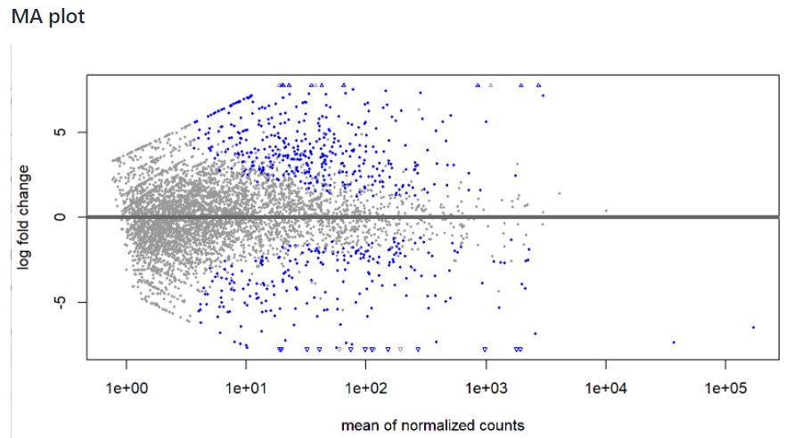
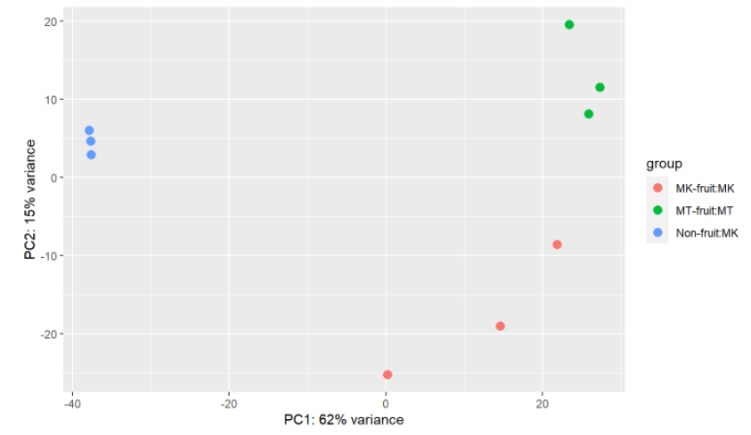
Differential expression analyses
2. Expression analysis (Deseq)
MA plot PCA plot
Notes:
MA:
y-axis: log fold change, positive-- upregulated, negative --downregulated
x-axis: mean of normalized counts ---means basemean (see in the summary(res))
bule point： significantly differentally expressed genes(adjusted padj < 0.05); grey points means not significant gene.
little triangles towards the edge: indicate these genes with higher fold changes and the direction of fold changes.
we expect to see: genes in the upper or lower right means these genes would have high mean of normalized counts with high log fold change, which would be our interesting candidate genes to furher looked into.
PCA:
we can see there are three distinct clusters(MK-fruit,MT-fruit,Non-fruit of MK), which means they have different gene expression.
there are more differences between the groups than within the groups.
The gene expression between Mk-fruit and MT-fruit samples are little separated along the PC2, since the PC2 only describe 15% variance, so these 2 goups are a bit of different but not that much. In my opinion, that's normal since both of these groups genes are from fruits of durian.
However, the gene expression of Non-fruit-MK is quite different from Mk-fruit and MT-fruit. Since the cluster of Non-fruit-MK is far from other 2 clusters along the PC1, PC1 describe 62% variance . That's quite good phenomenon which means fruits' gene expression that is different to Non-fruit.

Slide 14
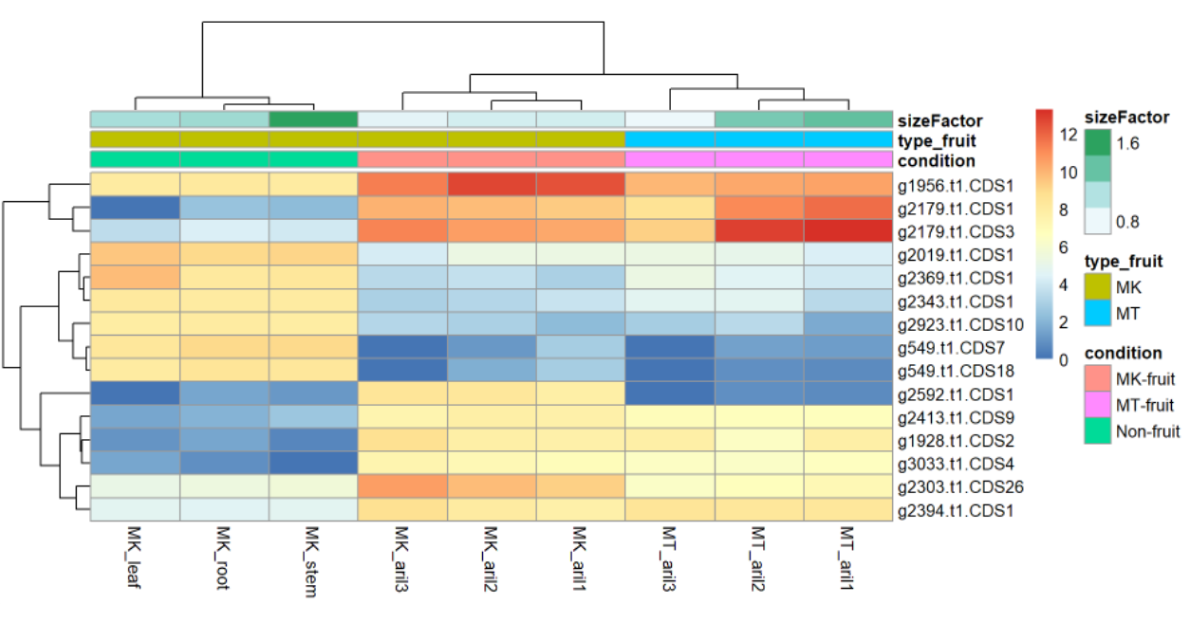
Differential expression analyses
Expression analysis (Deseq)
Heatmap Braker most significant genes:
gene ID | log2FoldChange | blastn
g2413.t1.CDS9 | -5.843577609 | WAT1-related protein
g2303.t1.CDS26 | -4.608321201 | uncharacterized ATP-dependent helicase YprA
g1956.t1.CDS1 | -4.183108123 | cytochrome b5
g2592.t1.CDS1 | -8.183953635 | inactive protein RESTRICTED TEV MOVEMENT
g2179.t1.CDS1 | -8.313190329 | NAC domain-containing protein
--------------- | ------------------ | -----------------------------------
g549.t1.CDS7 | 7.449003127 | trehalose-phosphate phosphatase
g2019.t1.CDS1 | 4.232219001 | nudix hydrolase
g2369.t1.CDS1 | 5.677171283 | 4-coumarate--CoA ligase
g549.t1.CDS18 | 6.726523605 | trehalose-phosphate phosphatase
g2343.t1.CDS1 | 4.816252696 | probable galactinol--sucrose galactosyltransferase
Notes:
The right heatmap:
red indicating higher expression and blue lower expression. And out heatmap echoes the previous PCA plot!
we can see that the expression of genes between MK-fruit MT fruit, Non-fruit groups are not different.
But The expression of gene between fruit and non-fruit groups are much different. for example obviously, genes with braker ID g2179.t1.CDS1 and g2179.t1.CDS3 are downregulated in non-fruit but upregulated in fruit.
the left table: The genes are arranged in ascending order of adjusted P-value from the Deseq result.
This table echoes to the heatmap.
Orange: 5 most significantly upregulated genes in Non-fruit groups(most downregulated in fruit),
Blue: 5 most significantly downregulated genes in Non-fruit groups(most upregulated in fruit)
Blast them to see their functionality.
Finally, we guess these kind of genes maybe related to the difference between fruit and non-fruit of durian like odor 欧 or sth. Like NAC protein: maybe related to the riping of the fruit
But compared with paper, we don't find the upregulation of MGL gene associated with sulfur-pathways in fruits, that's maybe coz we only use part of genome to do the project, or we need to extend the gene searching.

Slide 15
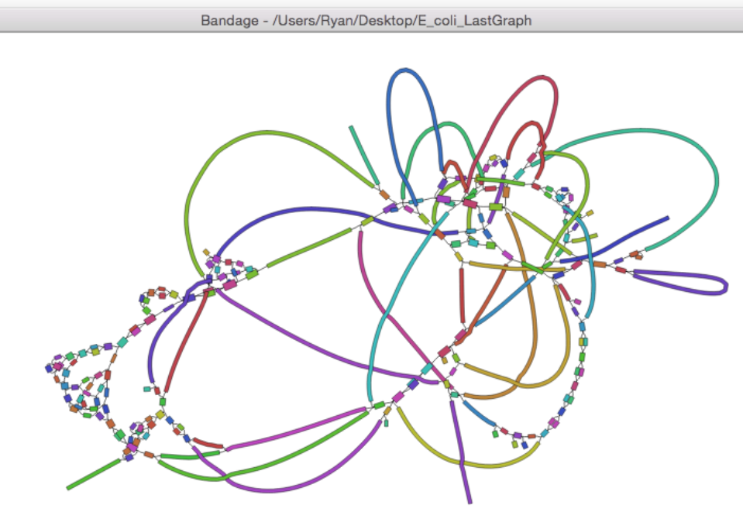
Transcriptome assembly (extra)
Trinity
There are 2 methods to run trinity
typical Trinity: do after the RNA trimmed and QC
Genome-guided Trinity: do after mapping. More accutare
Output: Trinity-GG.fasta
Visualization with Bandage
(but we don’t do that)
https://github.com/trinityrnaseq/trinityrnaseq/wiki/Output-of-Trinity-Assembly
Notes:
Genome-guided Trinity:
If a genome sequence is available, Trinity offers a method whereby reads are first aligned to the genome, partitioned according to locus, followed by de novo transcriptome assembly at each locus. Here, transcripts are reconstructed based on the actual read sequences.
I guess it’s more accurate than the other one.
The Trinity assembly can be visualized using Bandage：
Here only give a idea that how the transcriptome assembly result look like

Slide 16
Thanks/Questions?

